Slide 1
MAD-3115 Final Project (F2018) iOS Programming Fundamentals
Parking Space Booking System
Team:
1. Siva Prasad Uppalapati - C0744659
2. Amrik Singh Sidhu – C0724318
3. Preetwinder Kaur - C0743856
1

Slide 2



Project Risk & Dependencies
Risks:
1.As Project is more of static prone to multiple risks
2.Poor Authorization and Authentication.
3.Improper handling of code
4.Security and protection of Data
5.Data leakage
Dependencies:
1.Use of different Frameworks in the development
2.Usage constraints of code.
3.Framework Path Adjustments

Slide 3
Lessons Learnt
Learnt how to design and code for the application using XCode IDE.
To navigate one View Controller to another View Controller.
To pass data between View Controllers
UITable View Controller and Navigation Controller
Reading Plist Data, Image Picker and To Display HTML Content
Use of Core Data framework
Swifty Plist Manager (Third Party Manual Setup)

Slide 4
Difficulties Faced
Using Core Data Framework
TableView IndexPath (TableViewCell)
Database Ambiguous Error (more than one interpretation)

Slide 5
Technologies Used
XCode
Core Data Framework
DB Browser for SQLLite

Slide 6
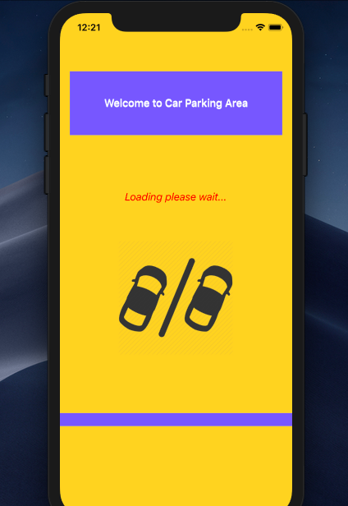
Launch Screen
Contains Launch screen with Welcome Text and Loading message

Slide 7
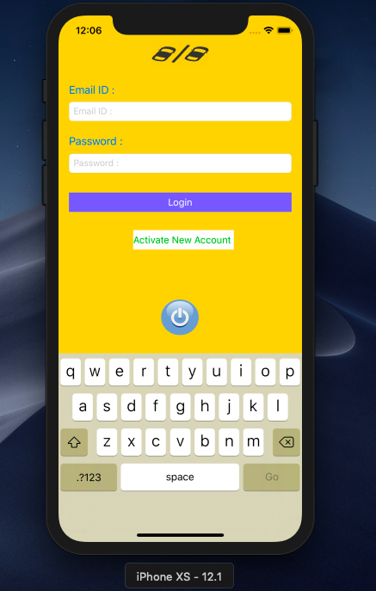
Contains Email and Password fields to login including a Registration of User
Login Screen

Slide 8
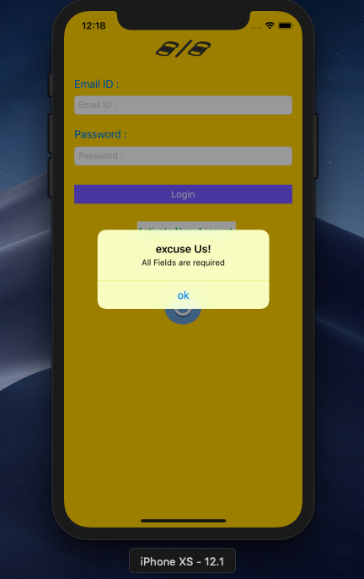
Message shown when Username and password fields are left empty.
Login Screen

Slide 9
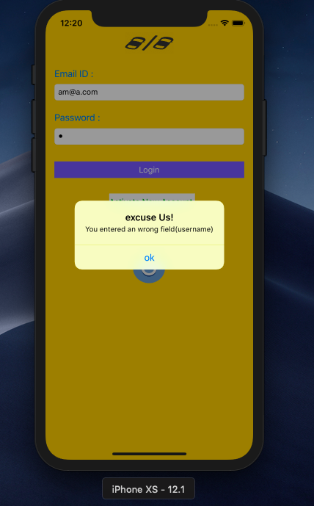
Error Message shown when Username is Incorrect.
Login Screen

Slide 10
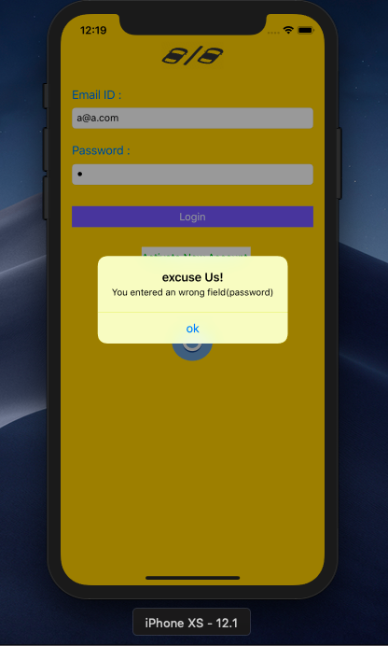
Error Message shown when Password is Incorrect.
Login Screen

Slide 11
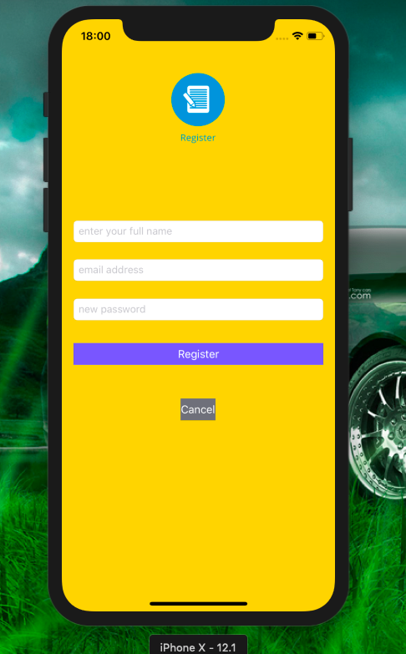
This Screen is used to create a new account for the customer. After creation of the account it will be redirected to Login Page
Registration

Slide 12
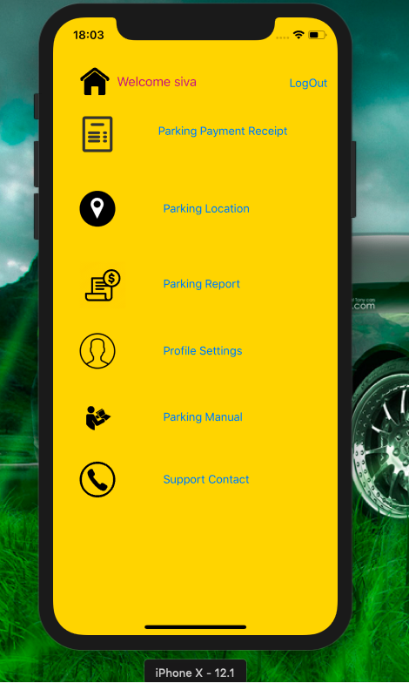
Contains options to Parking payment receipt , Parking Location, Parking Report, Profile Setting, Parking Manual and Support Contact.
Home Screen

Slide 13
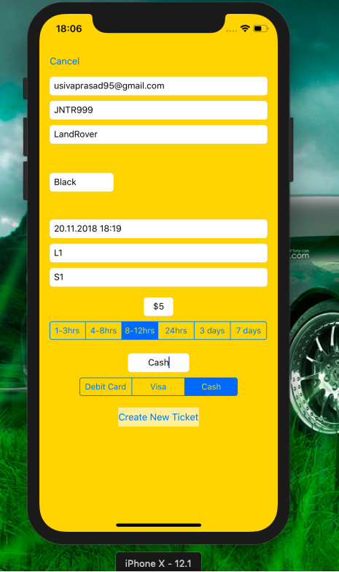
Contains options to enter the respective details and to create the new ticket
Parking Receipt

Slide 14
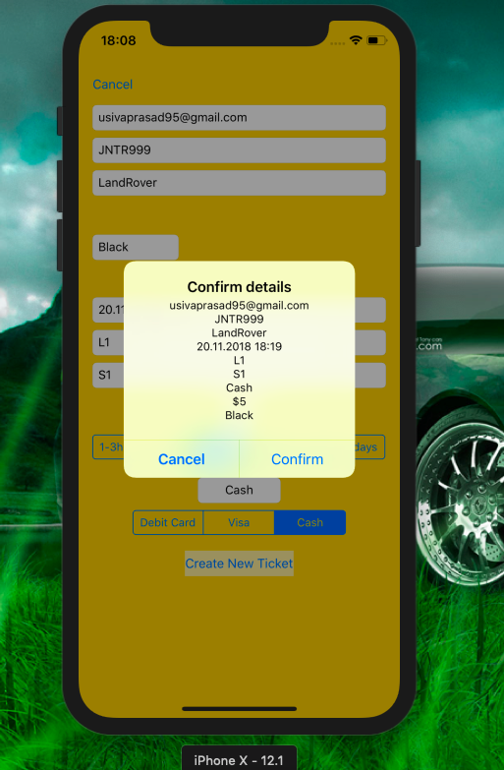
Alert shown to confirm the details entered. After confirming page will be redirected to home page with multiple options.
Parking Receipt

Slide 15
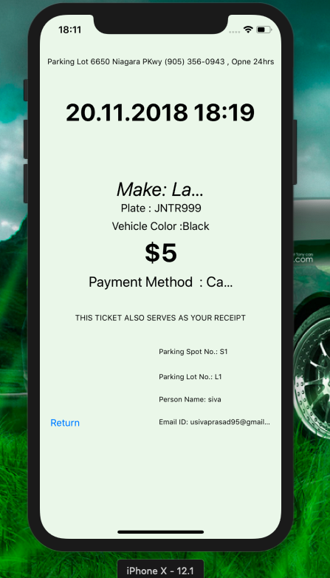
Shows the details entered by the user about the ticketing information.
Parking Report

Slide 16
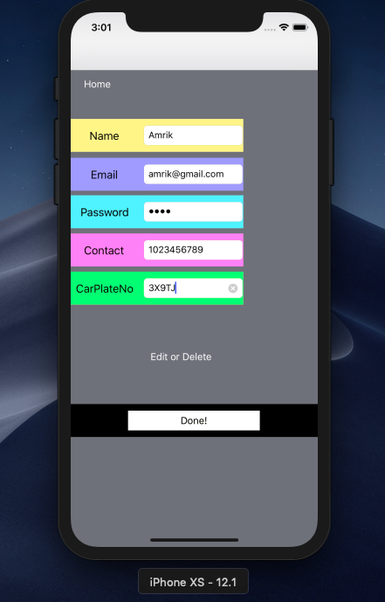
Contains fields like Name, Email, Password, Contact, CarPlateNo to create new account.
Profile Settings

Slide 17
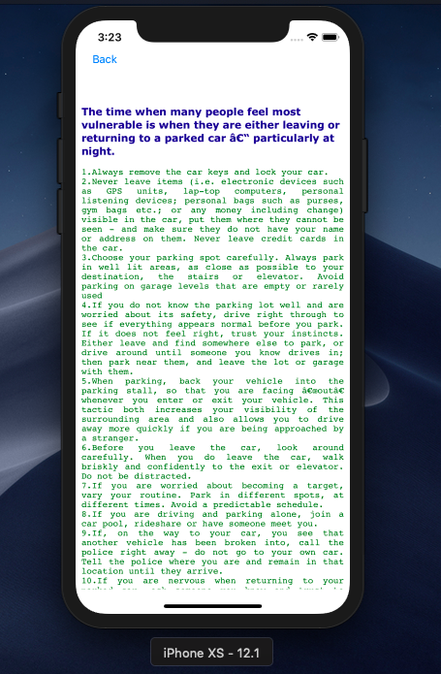
Gives the Terms and conditions of the parking manual.
Parking Manual

Slide 18
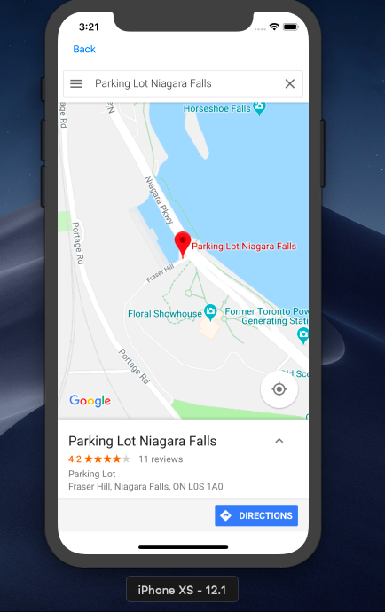
Gives the location of the parking lot where the car is parked.
Parking Location

Slide 19
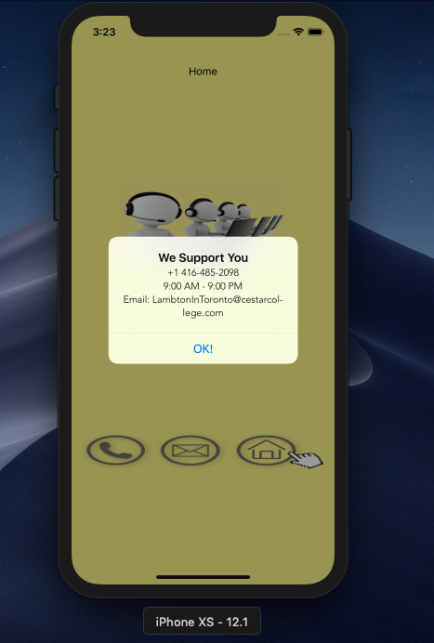
Gives the information of the support contact team.
Support Contact

Slide 20
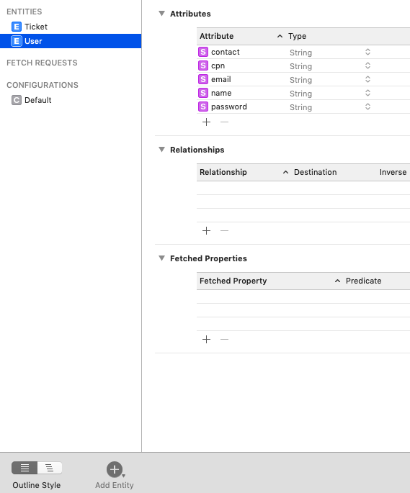
Gives the information of the user Entity and attributes in Core Data File
Core Data Persistence
Structure

Slide 21
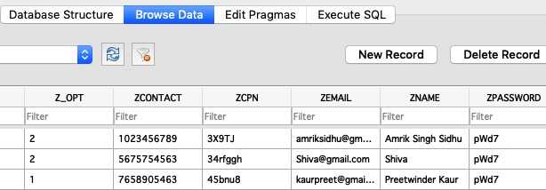
Gives the information of the user Entity Information in Core Data File
Core Data Persistence
User Information

Slide 22
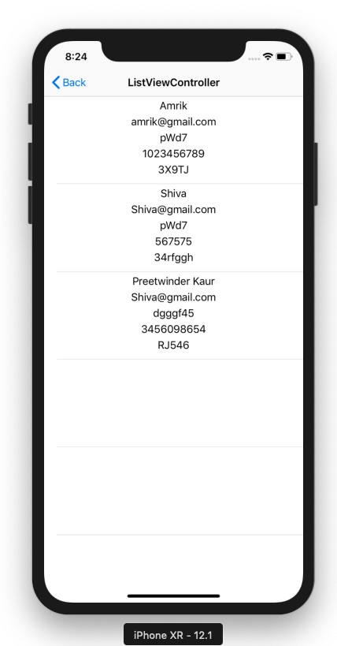
Gives the information of the user in TableView
Core Data Persistence

Slide 23
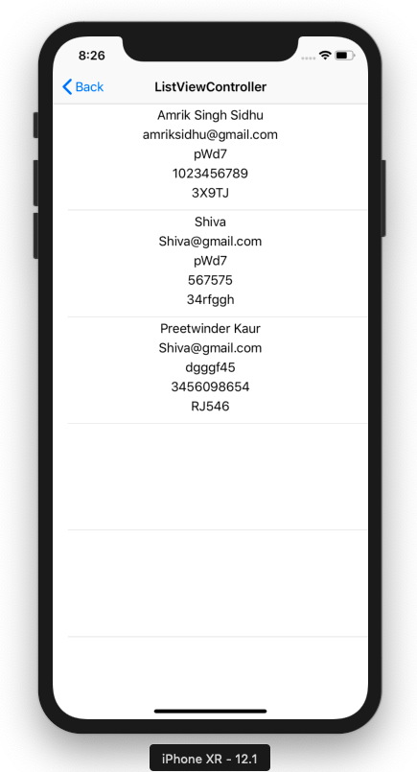
Gives the information of the user infoUpdated in TableView
Core Data Persistence
Updating

Slide 24
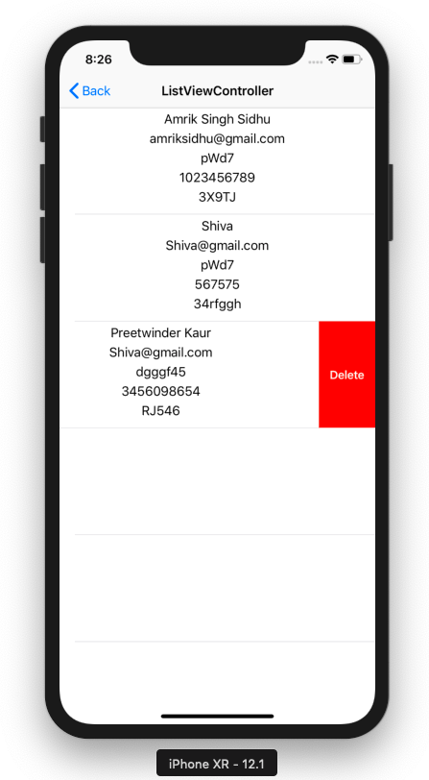
Gives the information of the user infoDeleting from TableView
Core Data Persistence
Deleting

Slide 25
References
https://developer.apple.com
https://youtu.be/JTtYSJtVKMc
https://youtu.be/WCCafo-OPn8
https://stackoverflow.com
And Many Other Youtube Links.

